Slide 1
OPEN-MESH ROAMING WiFi NETWORK:
Group II Members:
*Pandi Kirupa(0907959)
*Lakshmanan(0847014)
*Mihir Vetekar(0880961)
*Juspreet(0839049)
*Jayahasan(0897670)

Slide 2
Project Goals
Is to setup at least a three WAP roaming wireless network and test security performance and coverage.
To successfully implement the major test and analyze the surrounding networks and test performance.

Slide 3
Introduction
A mesh network is reliable and offers redundancy.
Wireless mesh networks can be implemented with various wireless technology including 802.11, 802.15, 802.16, cellular technologies or combinations of more than one type.
Wireless mesh infrastructure is, in effect, a network of routers minus the cabling between nodes.
Open-Mesh makes it easy to get wireless coverage exactly where you need it.
Open-Mesh single band enclosures are designed specifically for the tiny, powerful OM Series access points and blend in seamlessly in any office, hotel, warehouse or apartment block.

Slide 4
Abstract
Do you have a home or office that is particularly tricky to get covered with a WiFi network? Well, Open-Mesh to the rescue! The Open-Mesh WiFi system is the best ever experienced when it comes to coverage, ease of installation and price.With the help of three access points we created and performed baseline performance evaluations with several standard testing methods.A basic site survey was conducted before and after deployment of the mesh network.As a result,an environment who built with te help of access points which were able to accept the interference occurred from things like microwave ovens, other access points and other sources of interference.

Slide 5
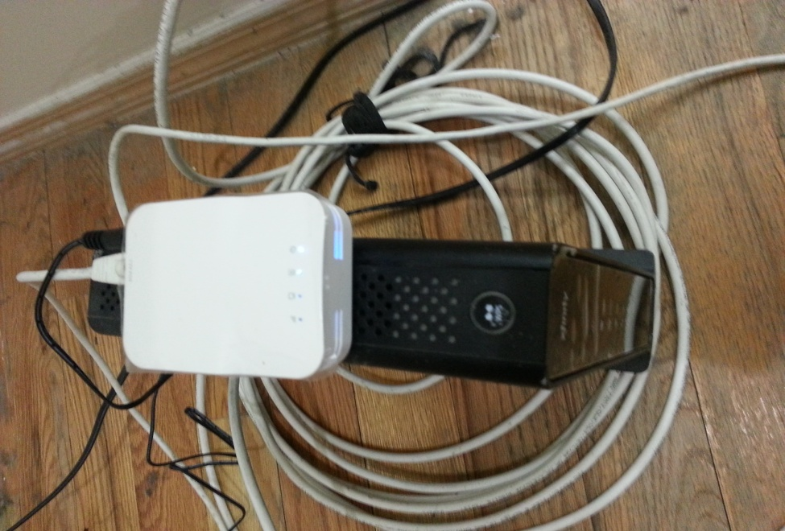
PROPOSED SYSTEM
Phase 1:Pre-Deployment
Procured three access points.Connected two access points initially and checked the speed of the Wi-Fi
(Access Point 1)

Slide 6

(Access Point 2)
Used CAT5e cable to connect each access point.

Slide 7
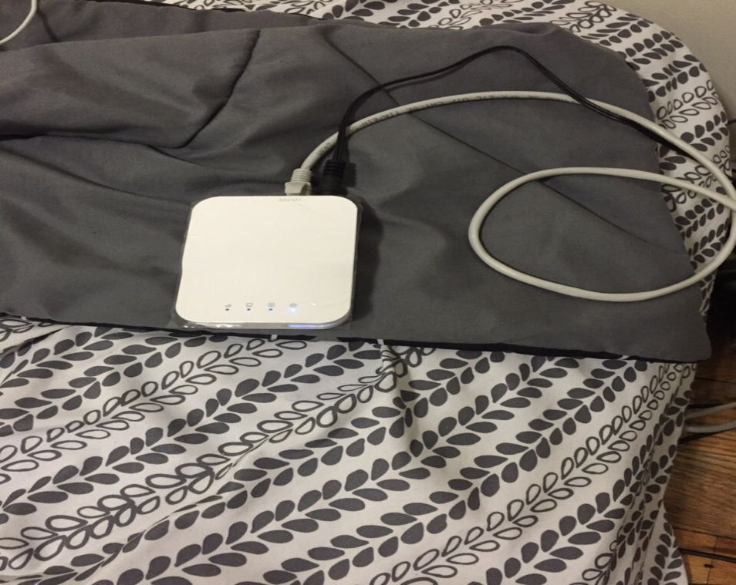
Access Point 3

Slide 8
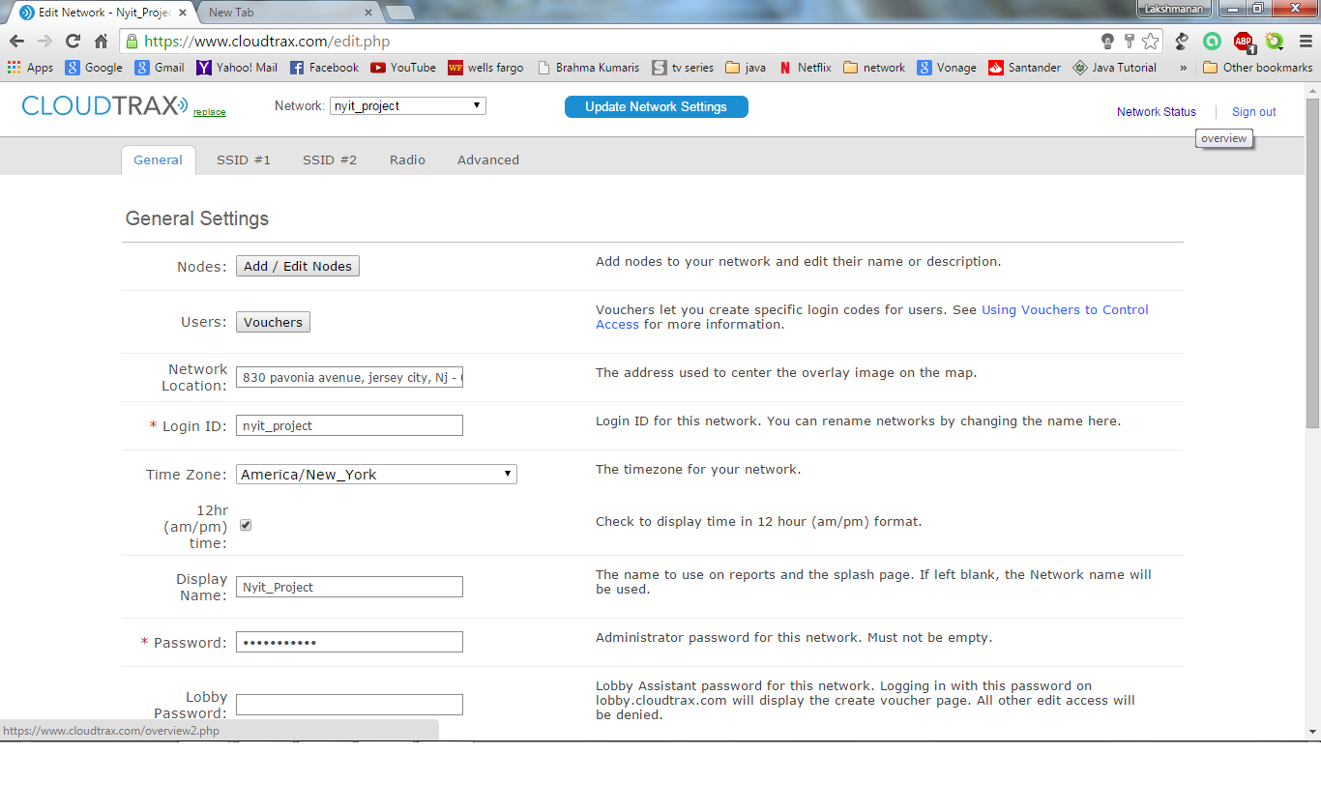
We identified the site to install the WAPs. Above I have given an address proof by CloudTrax

Slide 9
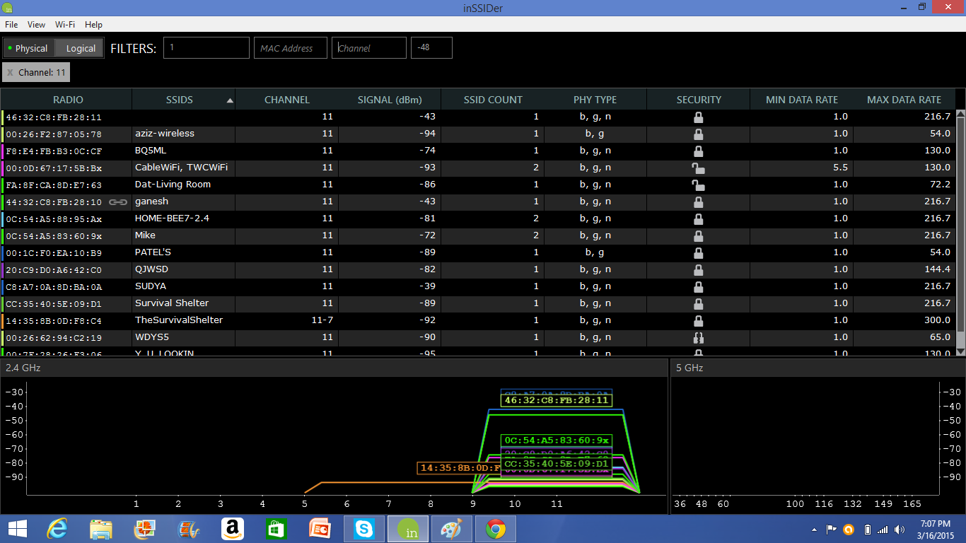
Below is the screenshot of the Access Points which uses the same channel 11(screenshot taken before our installation of access points)

Slide 10
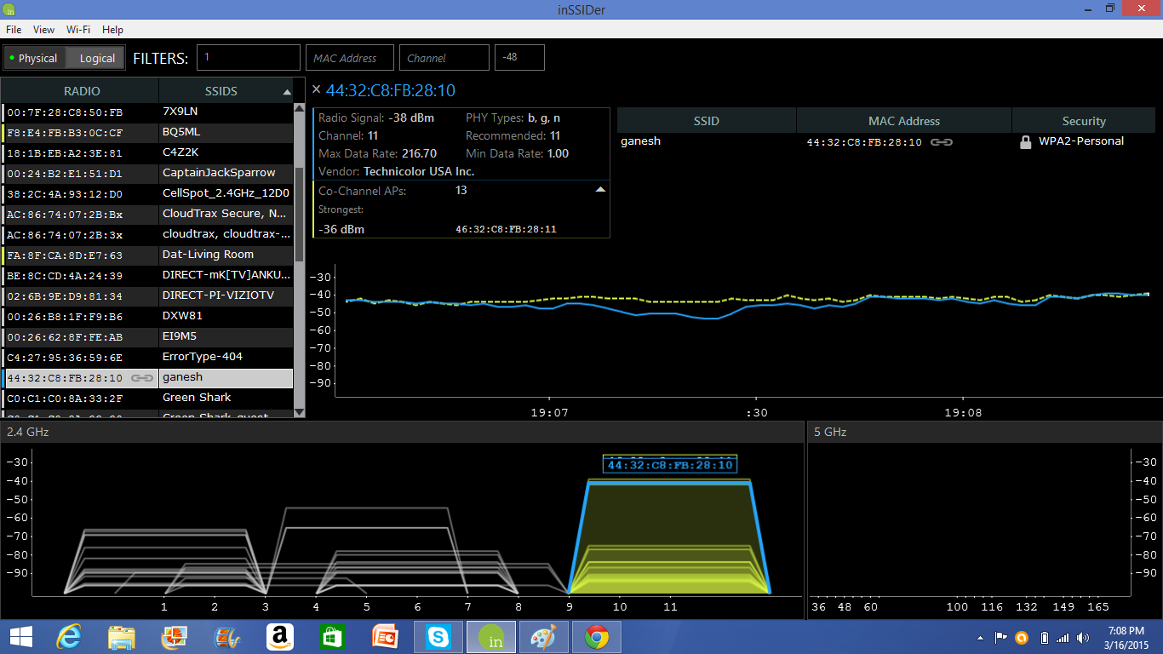
We didn’t experience any interference in our network. The green signal shows that there is a strongest network than us where as we didn’t get any red line which denotes the interference.
Interference in the area

Slide 11
Phase-2 (Infrastructure Deployment)
We connected all three WAPs with cat5e cable and wired it to Main switch.
All connections were laid out by our floor plan(which I sent you last week)
AP1 is connected in the living room,AP2 in the kitchen and final one in the bedroom
We gave same SSID for all WAPs as NYIT Project 1
For two APs we choose channel 6 and other one on channel 4(We have a question in channel selection)

Slide 12
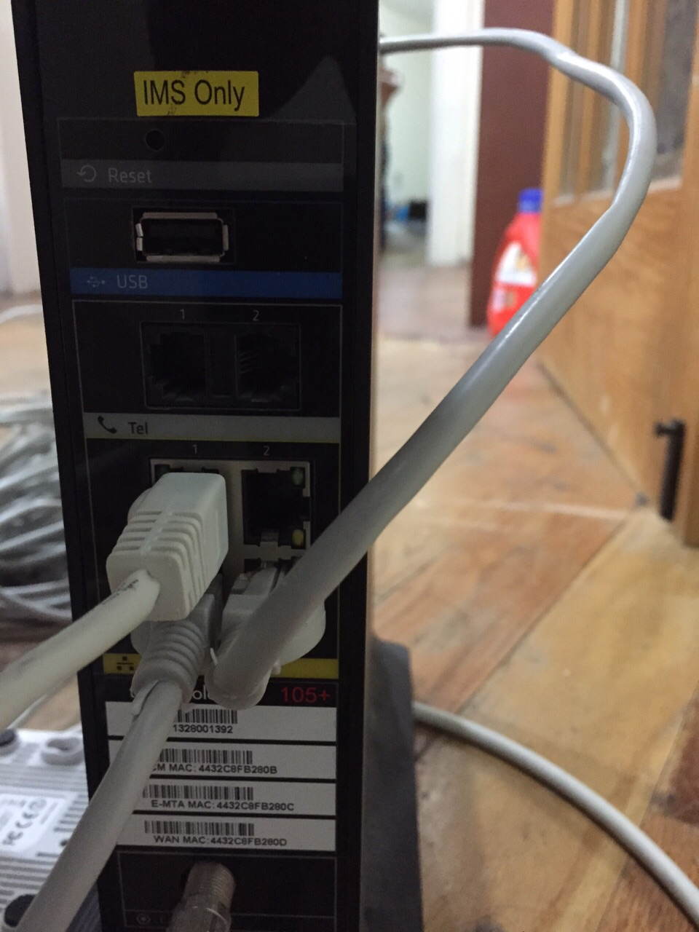
Below I have attached all the photos of our work done: This picture shows the cat5e cables connected to all three WAPs.

Slide 13
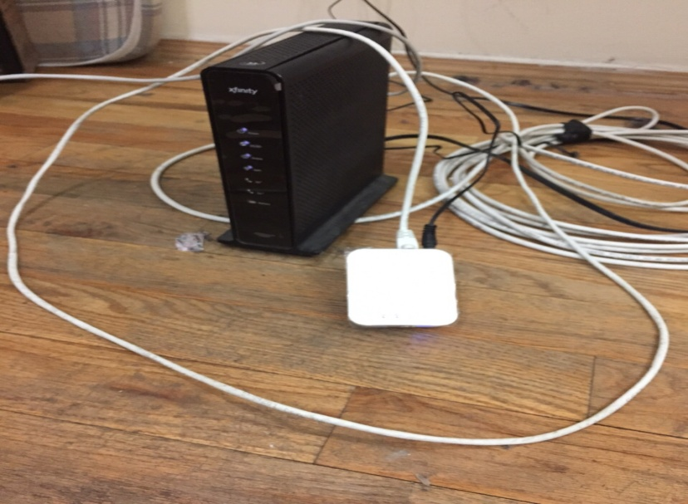
According to our floor plan, AP 1 in the living room

Slide 14
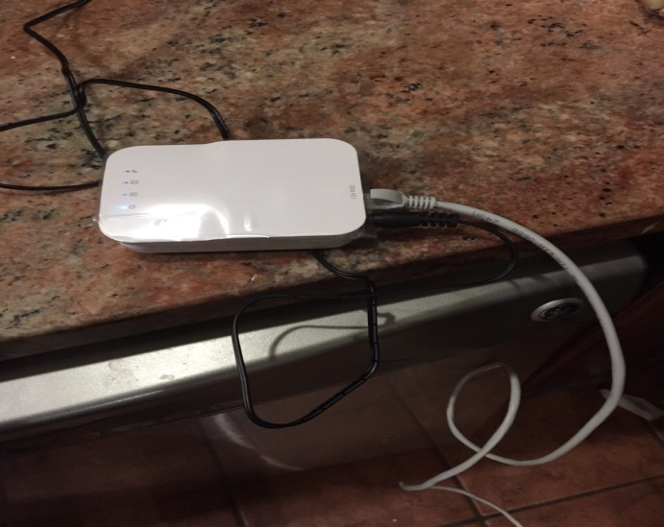
AP 2 installed in the kitchen

Slide 15
AP 3 installed in the bedroom

Slide 16
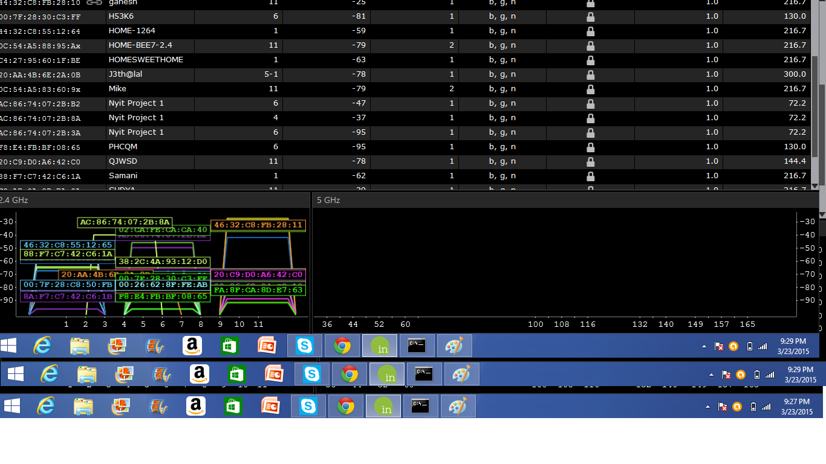
Inssider 4 which shows all the three SSID (NYIT project 1) in the optimal channel we chose.

Slide 17
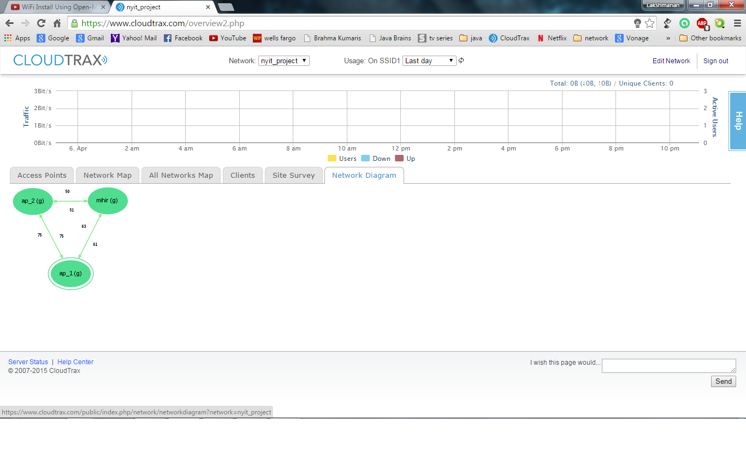
Phase 3(Major tests conducted)
All Three access point connections_1

Slide 18
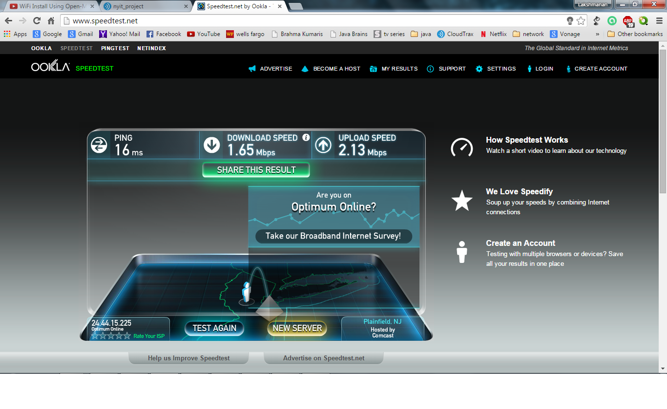
Internet speed(Before connecting to the access point)

Slide 19
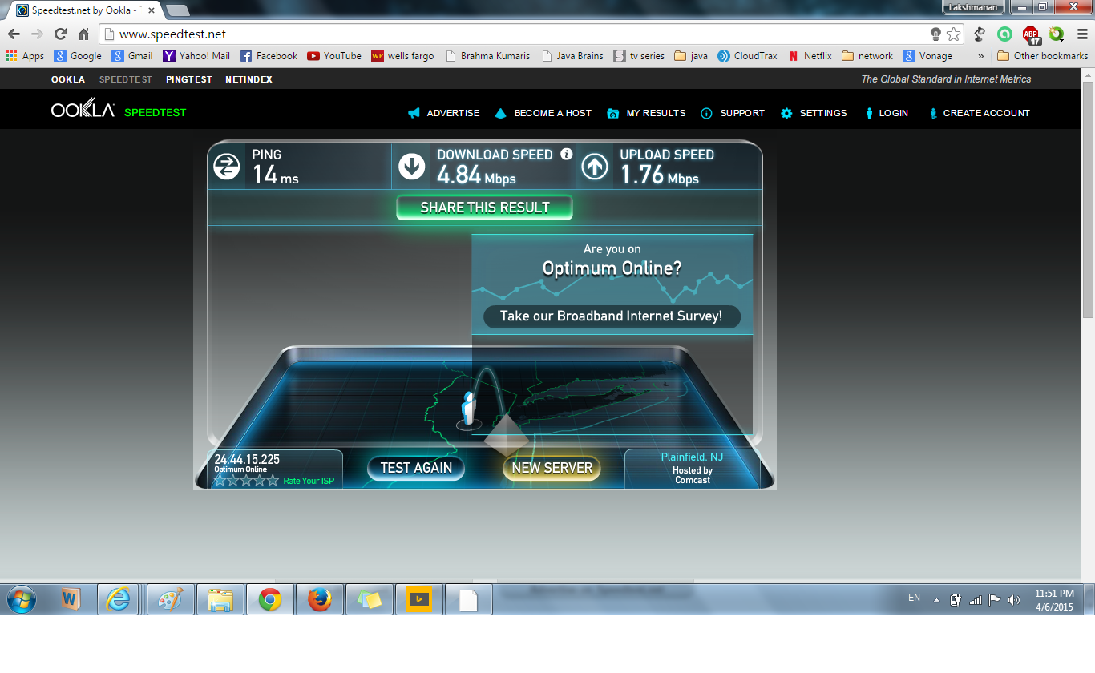
Internet speed(After connecting to the access point)

Slide 20
Attenuation test
Test Setup:
Two wireless routers.
A working network connection.
A machine you can temporarily hard-wire into the routers so you can set them up.
Adding two wireless access points (Wireless Routers) using the same SSID so that wireless coverage.
Set up wireless security on both routers.
Set up routers such that there are no DHCP or channel conflicts.
Step 1: Configure SSID
Step 2: Configure wireless security
Step 3: Configure DHCP
Step 4: Locate and fire up!

Slide 21
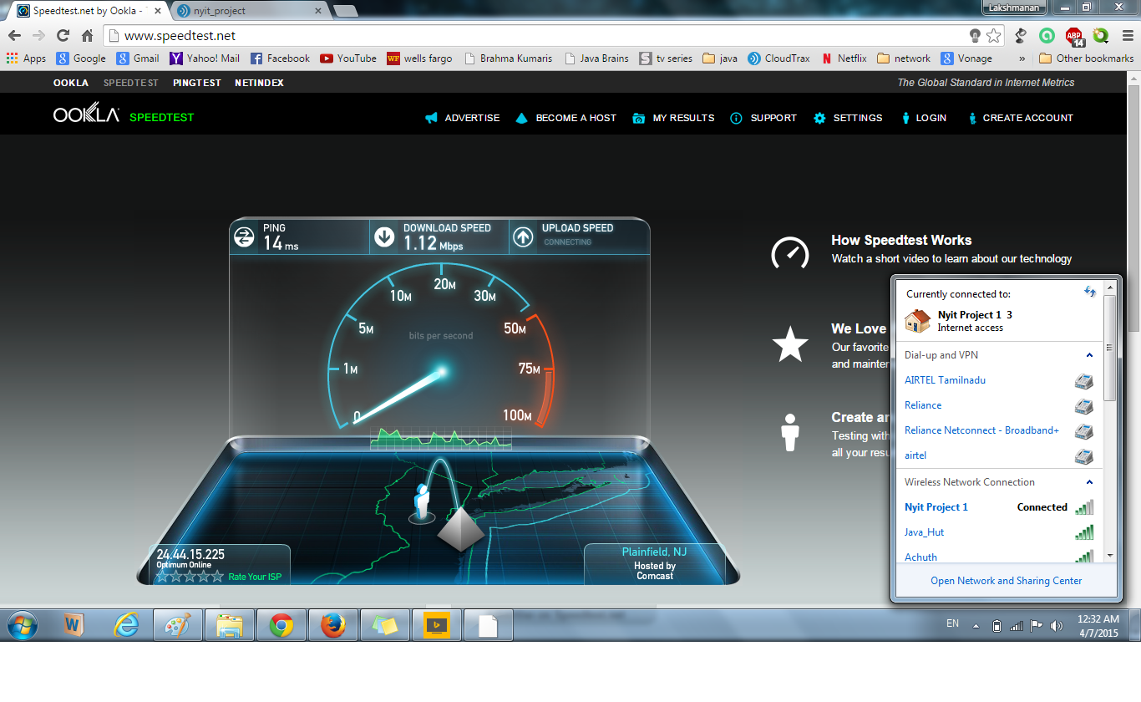

Slide 22
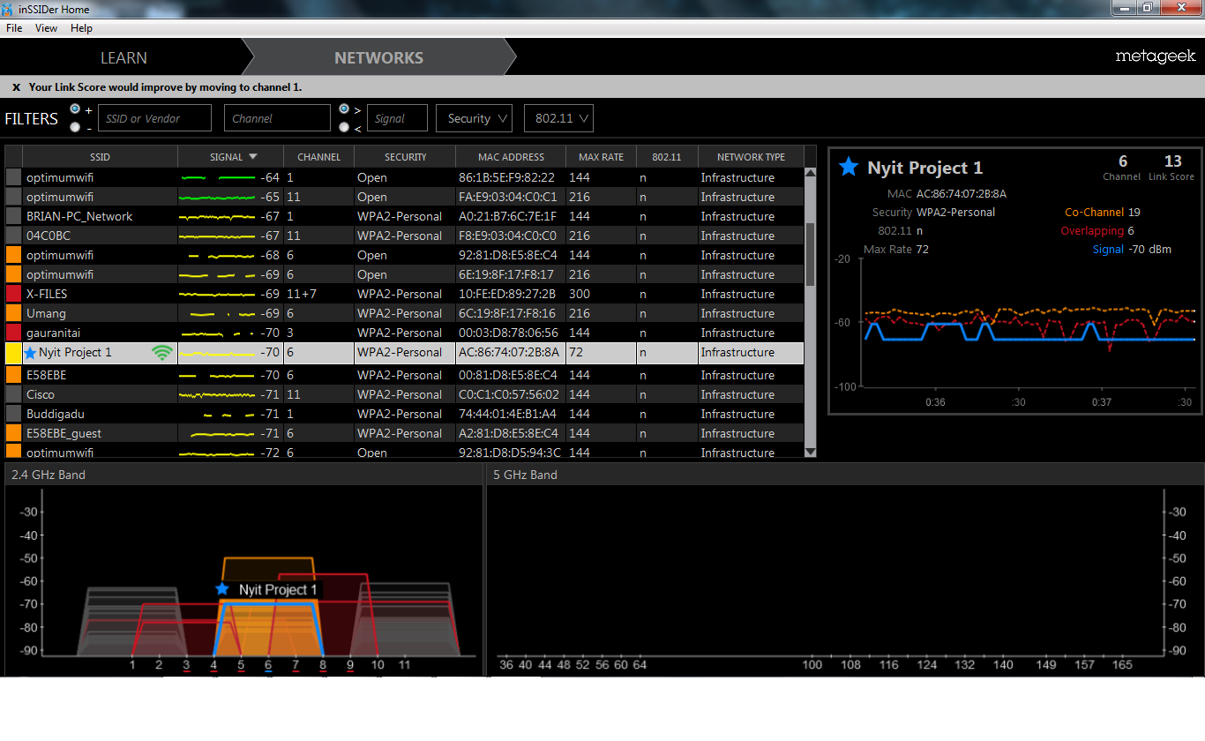

Slide 23
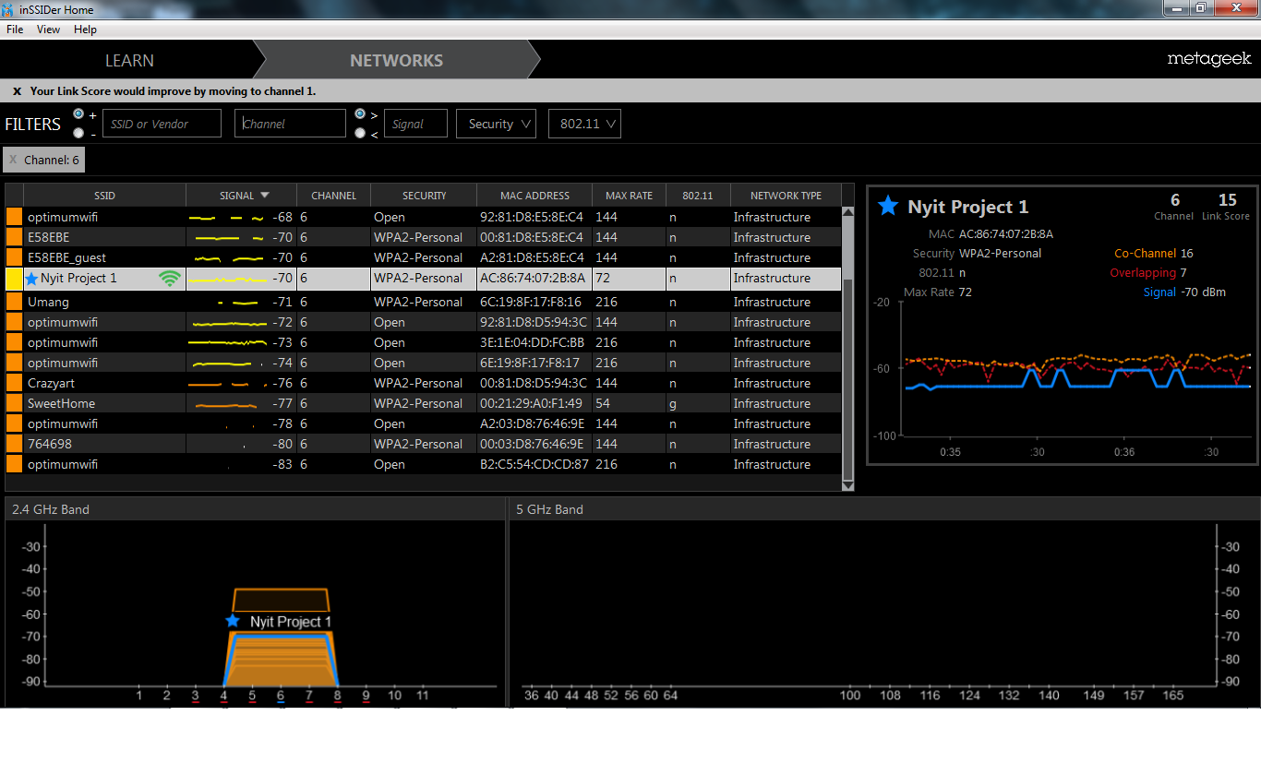

Slide 24
Channel Performance Test:
Wi-Fi equipment’s must share spectrum bandwidth which are spaced around multiple channels bands with other networks in the same operational environment.
Channels 1, 6, 11 is recommended for the minimum overlapping and interference avoidance.

Slide 25
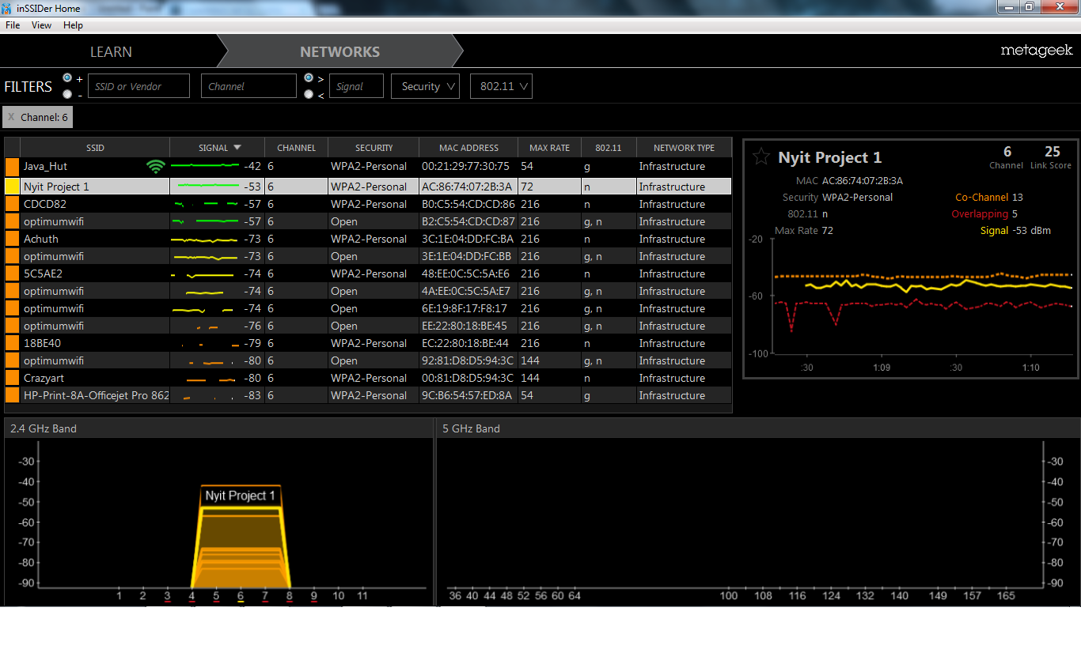
@Channel 11

Slide 26

@Channel 6

Slide 27
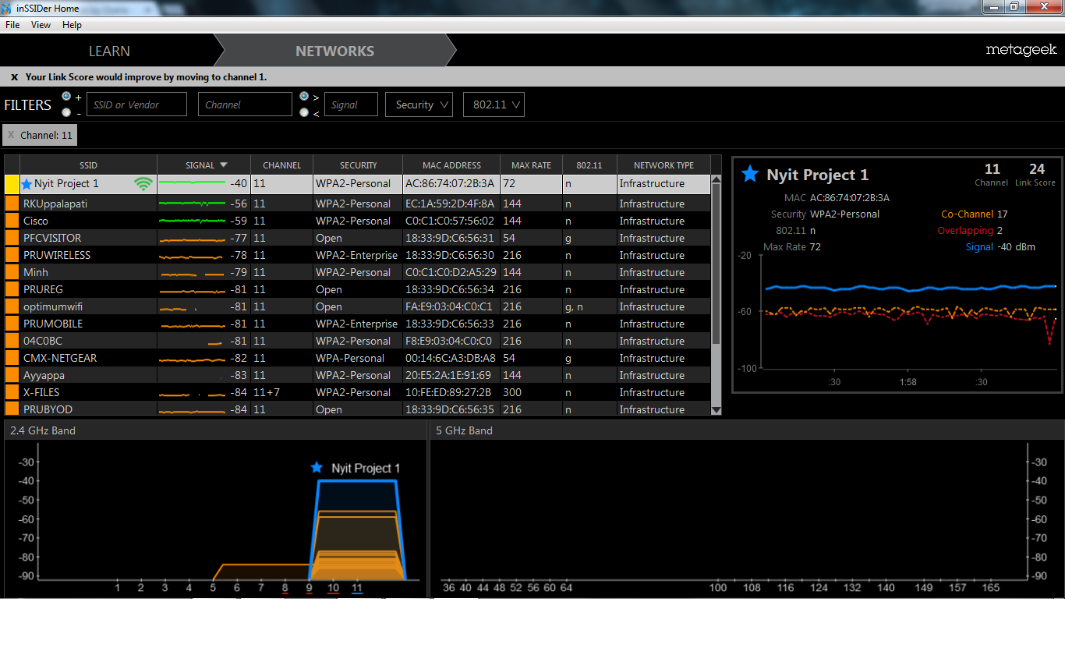
@Channel 6

Slide 28
Interference test :
Slow connectivity in an area can be caused by competing networks on the same or overlapping channel.
Your best option is to use a channel with no overlapping networks or share a channel that has networks with low signal strength.

Slide 29
Dead Spots from Non-Wi-Fi devices
Sometimes you may have excellent signal strength, but little to no connectivity. These dead spots can be caused by competing wireless devices that use the same frequencies as Wi-Fi, but do not cooperate with Wi-Fi. Here are a few common devices that cause dead spots in the home:
Cordless Phones
Baby Monitors
Wireless Audio Systems
Nanny Cams
Microwave Ovens
Wireless Security Systems

Slide 30
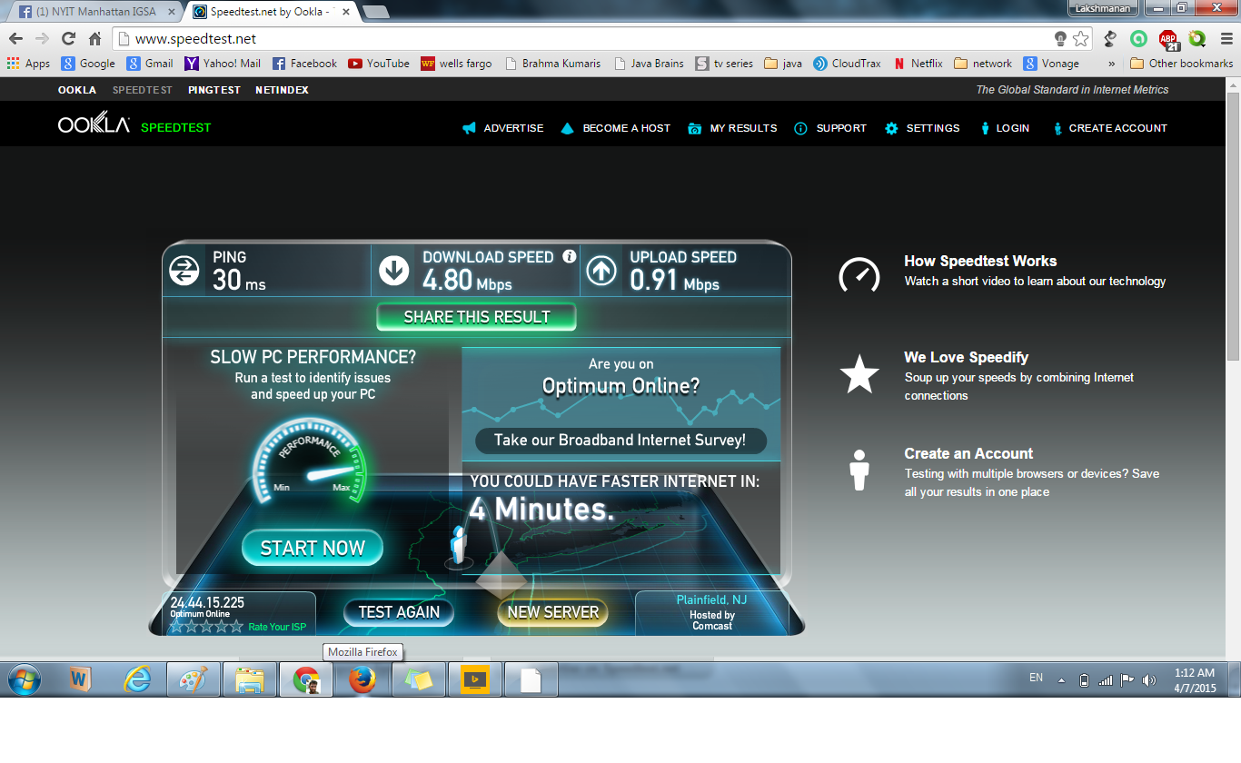
Interference_Test_1(Check_the_PING)

Slide 31
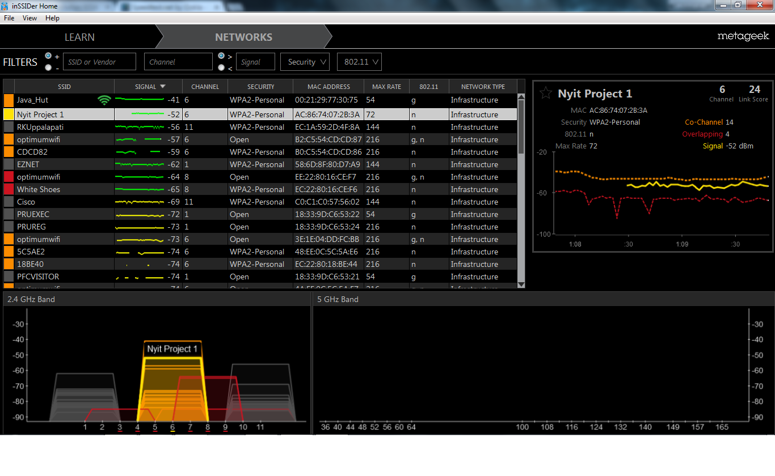

Slide 32
Mobility Performance Test:
Connectivity is a basic concern in designing and implementing wireless networks. Clustering and mobility have been found to improve various aspects of network performance.
We have taken all our WAPs and and tested based on our floor plan and checked the speed of the internet.
We have given more than 5 screenshots which clearly shows the variation in our networks speed which makes us understand where we get more access to the network apart from the interferences and attenuation it came across.

Slide 33
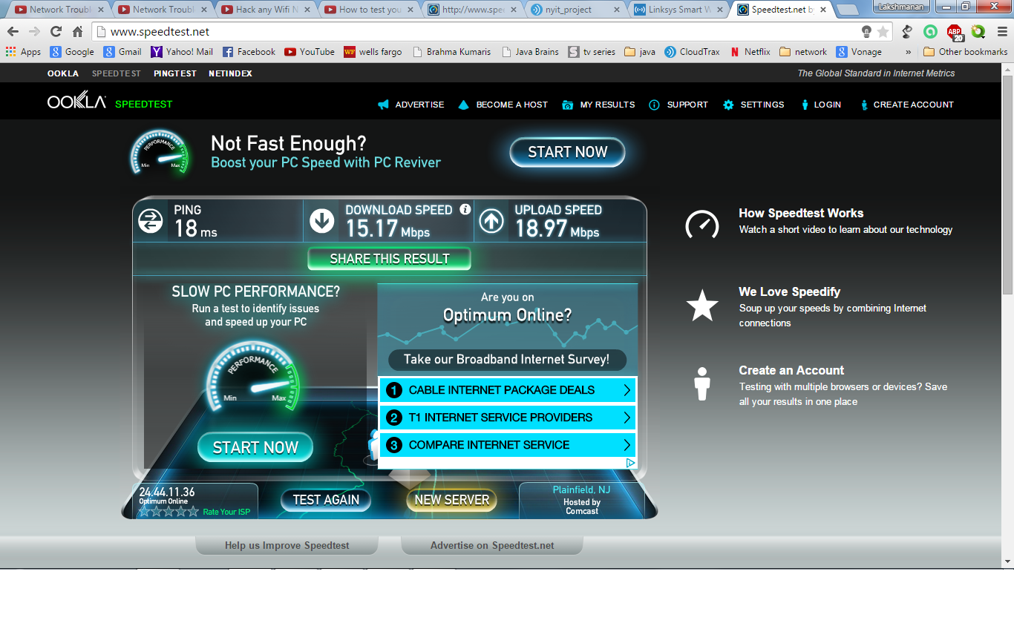
Myhome_network_speedtest

Slide 34
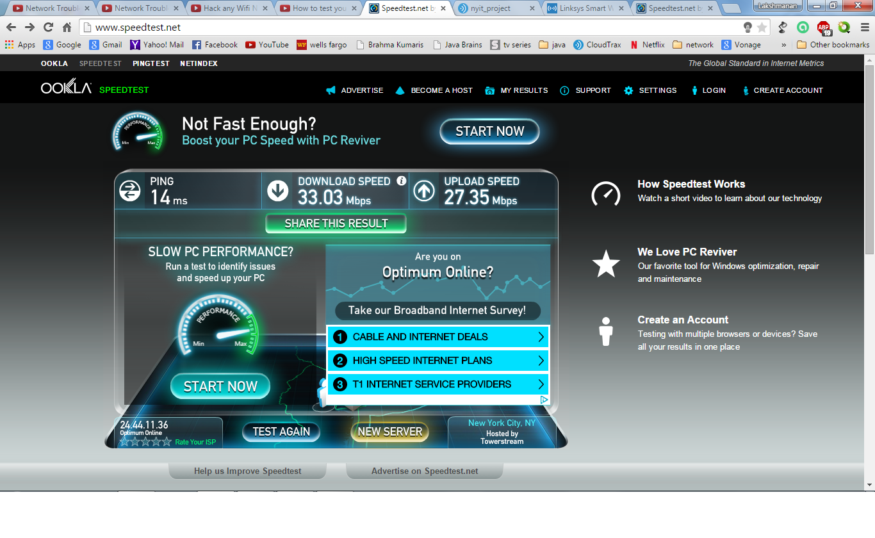
Mobility_performance_test_1

Slide 35

Mobility_performance_test_2

Slide 36
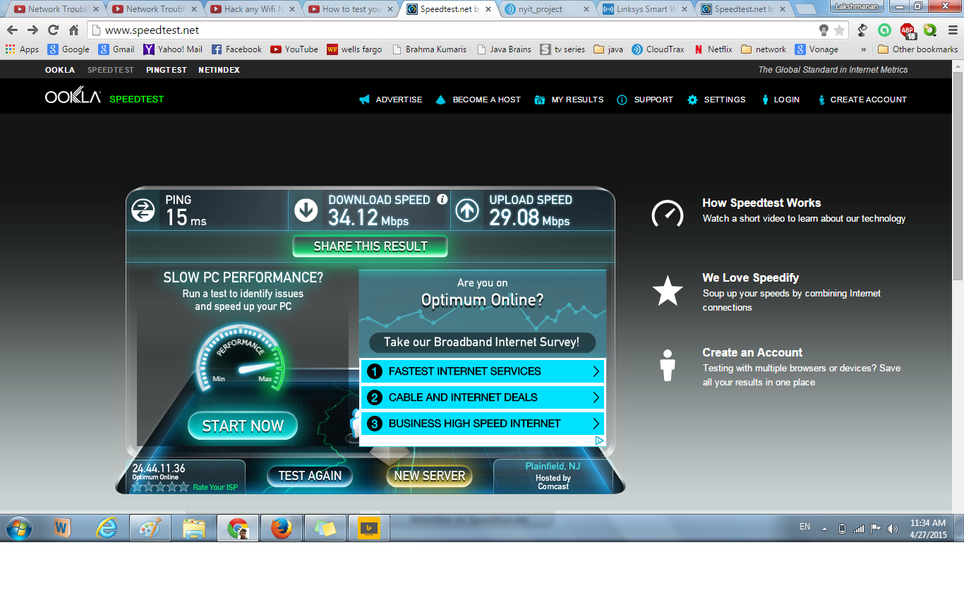
Mobility_performance_test_3

Slide 37
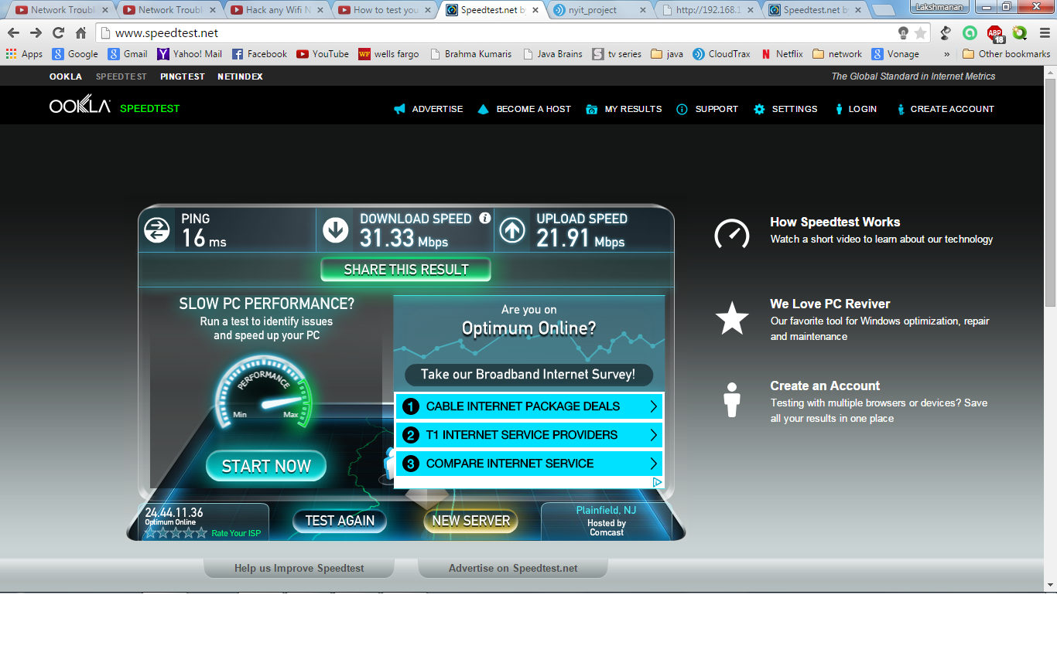
Mobility_performance_test_4

Slide 38
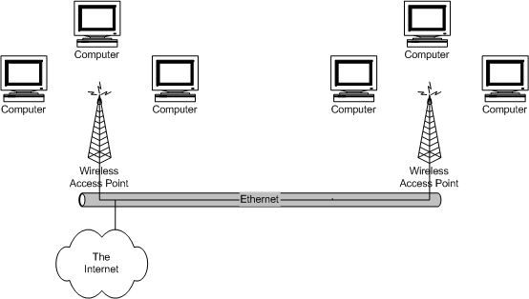
WAP failure test:
We planned to have both access points wired together, and perhaps placed a fair distance apart then this should work. This diagram illustrates that scenario:

Slide 39
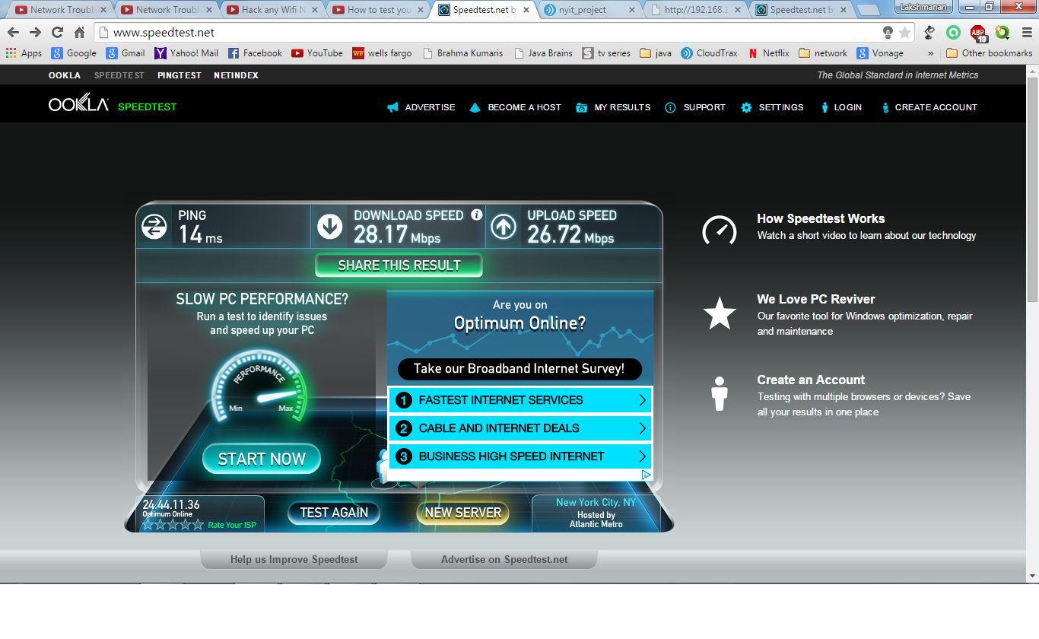

Slide 40
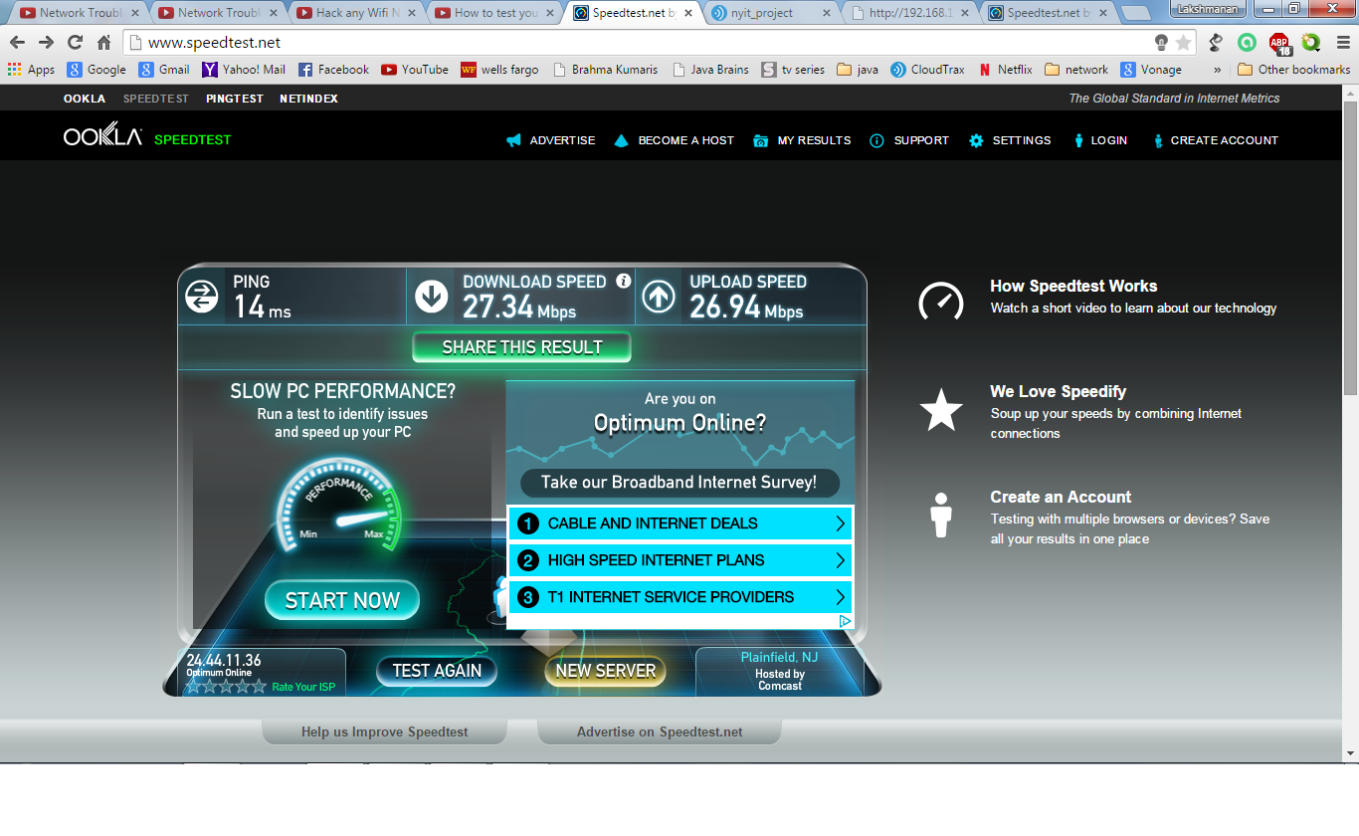
The change in our download speed is illustrated by the above two screenshots

Slide 41
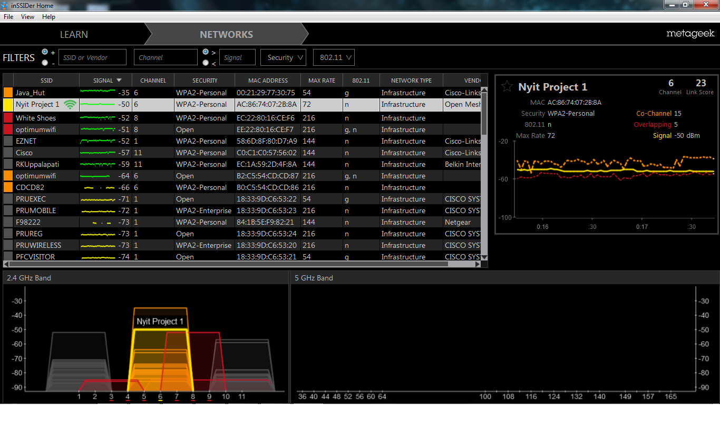
WAP_Failure_TEST_Overview

Slide 42
Ipconfiguration test
Ipconfig:
The IPCONFIG command displays all current TCP/IP network configuration values.
It gives you basic information to get your IP address, your router’s IP address, DNS Server IP address, DHCP Server IP address, etc…

Slide 43
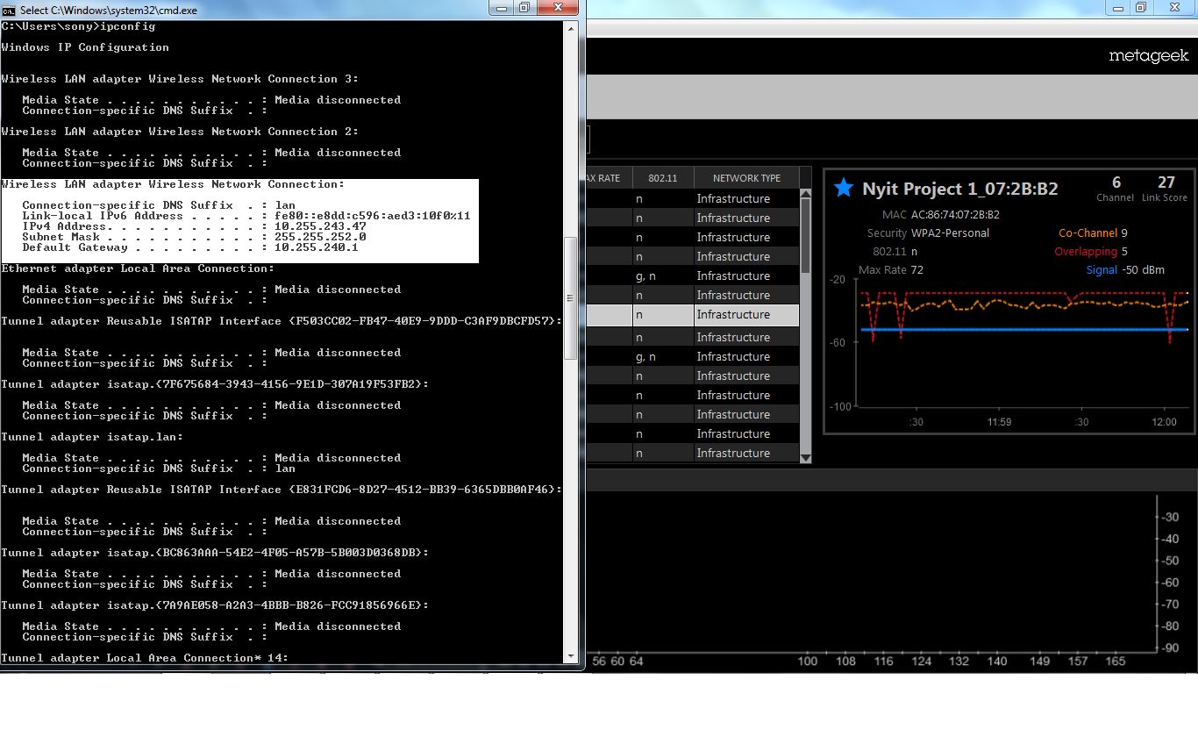
Ipconfig_test(wireless_connectin_details)

Slide 44
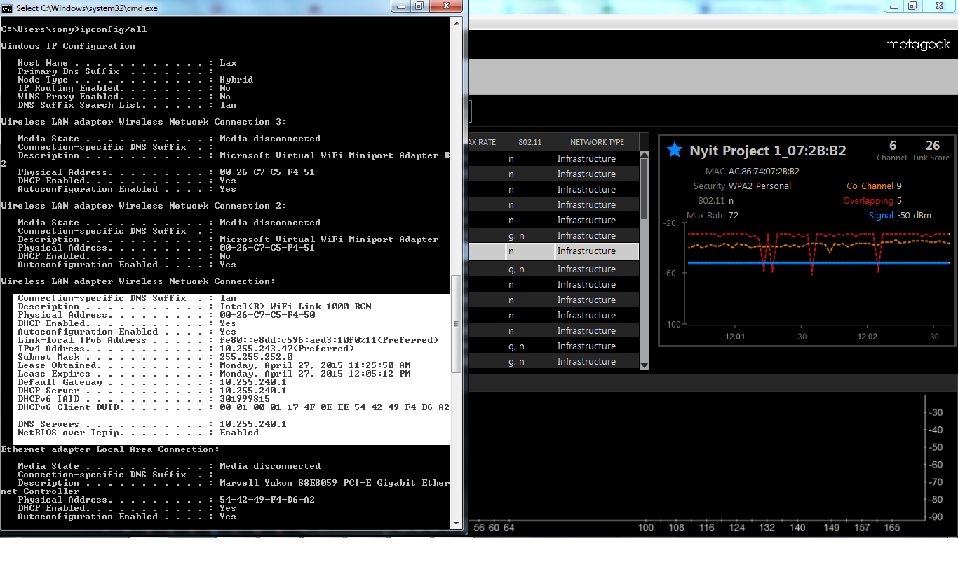
Ipconfig/all_test(wireless_connectin_details_indepth)

Slide 45
Ping test
Ping:
Allows you to send a SIGNAL to another Device on the NETWOR to see if it is ACTIVE.
HOW IT WORKS?
Uses the ICMP(Internet Control Message Protocol) to send out an “echo request” to the destination device, and gets back an “echo response” if the device you are trying to reach of in fact ACTIVE.

Slide 46
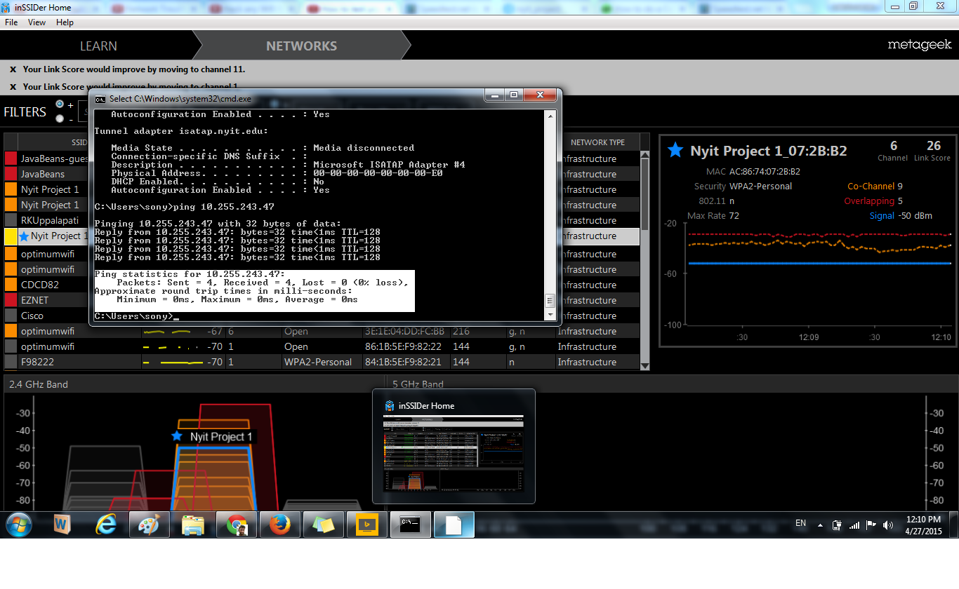
Ping_test_nyitProject_1_ipaddress
Ping statistics for 10.255.243.47:
Packets: Sent = 4, Received = 4, Lost = 0 (0% loss),
Approximate round trip times in milli-seconds:
Minimum = 0ms, Maximum = 0ms, Average = 0ms

Slide 47
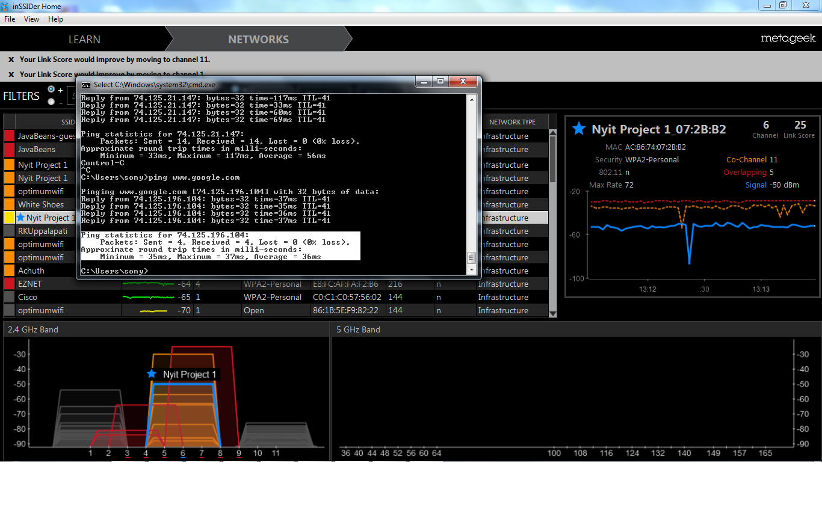
Ping_test_nyitproject_google.com(check the time difference between google and ipaddresss)
Ping statistics for 74.125.196.104:
Packets: Sent = 4, Received = 4, Lost = 0 (0% loss),
Approximate round trip times in milli-seconds:
Minimum = 35ms, Maximum = 37ms, Average = 36ms

Slide 48
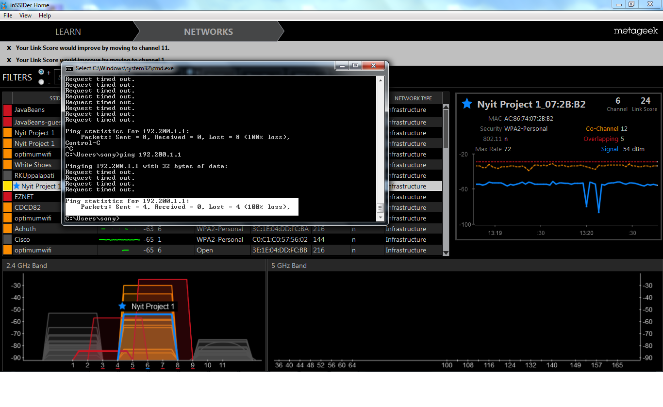
Ping_nyit_project_givencmd_doesnt_exist
Ping statistics for 192.200.1.1:
Packets: Sent = 4, Received = 0, Lost = 4 (100% loss),

Slide 49
Tracert Test
TRACERT:
TRACERT let’s you see, the step-by-step route a packet takes to the destination you specify.
So, if you send a packet to google.com, before the packet actually reaches google.com servers, it will go through many different routers before it finally reaches google.com.
You can also use the term HOPS instead of routers. So, if it takes 10 routers to get to google.com, you can instead say, “it took 10 hops”.

Slide 50
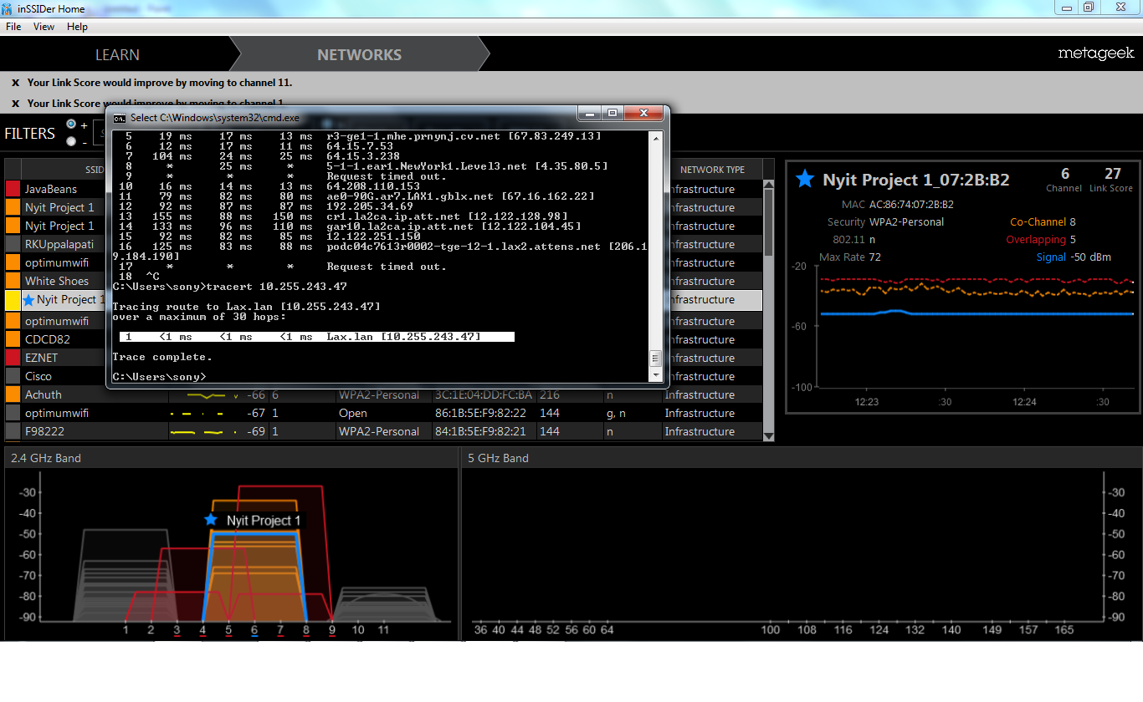
Tracert_myipaddress_Test

Slide 51
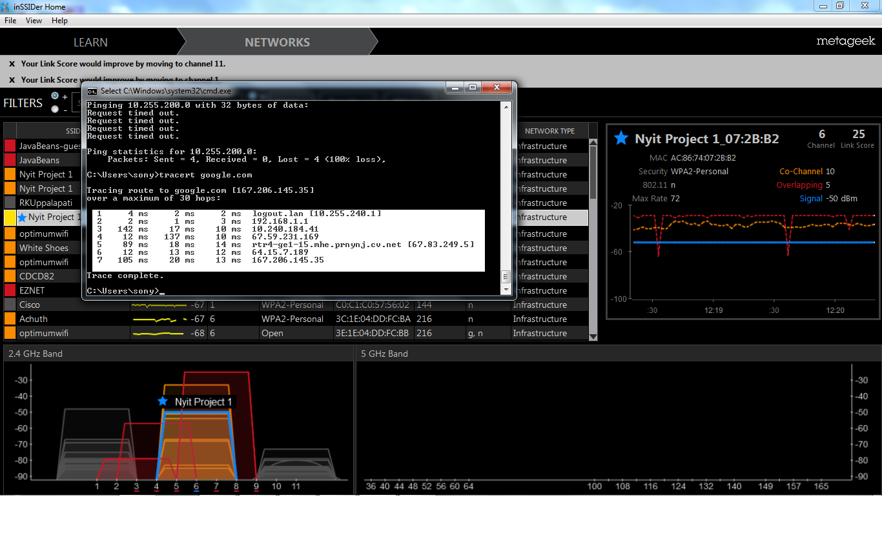
Tracert_google_test

Slide 52
Nslookup Test
NSLOOKUP:
This command will fetch the DNS reocords for a given domain name or IP address. Remember, the IP addresses and domain names are stored in DNS Servers, so the nslookup command lets you query the DNS Records to gather informantion.

Slide 53
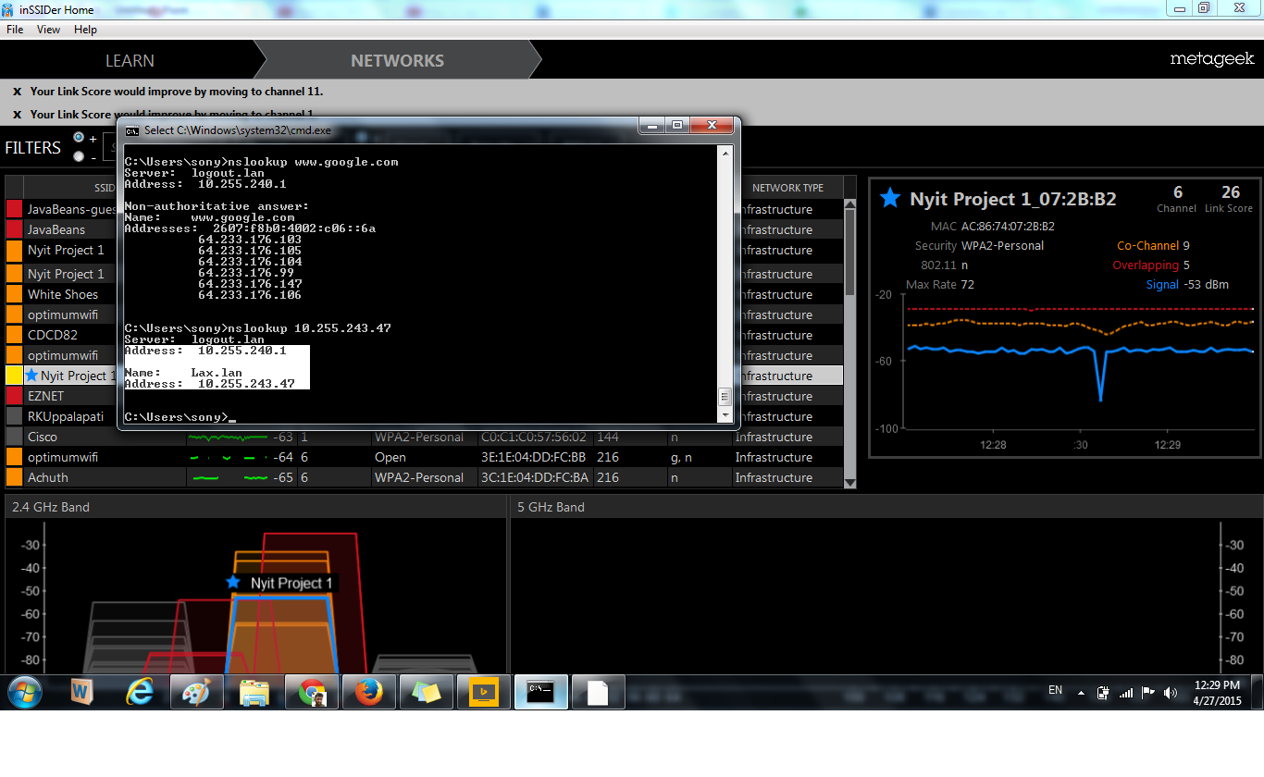
Nslookup_test_myipaddress

Slide 54
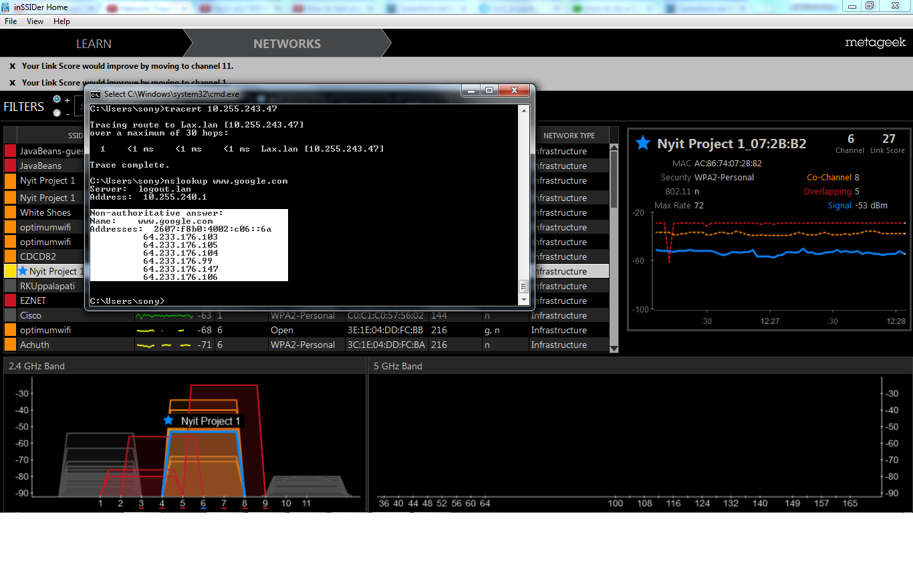
Nslookup_test_google

Slide 55

Splash Page

Slide 56
Conclusion
We conducted several standard testing methods and base line performance evaluation were conducted.
All the methods were repeated with consistent results as a control set before it is used to evaluate production interference.
The over all open mesh roaming for domestic purposes were cost effective and significant.
The above results are all quantifiable performance oriented and repeatable testing methods.

